Slide 1

Reduced Order and Ensemble Modeling
RAVEN Workshop
PHYSOR 2016 – May 1st 2016, Sun Valley (ID)

Slide 2
Outline
RAVEN models: brief overview
Reduced Order Modeling
Brief introduction
When we can apply them
ROMs and RAVEN
Ensemble Modeling
Application examples of Reduced Order and Ensemble Modeling

Slide 3
RAVEN models: overview

Slide 4
RAVEN models: a quick introduction
RAVEN categorizes in its Models entity the following sub-entities:
Codes:
Aimed to interface with physical codes (e.g. RELAP5-3D, etc.)
ROMs:
Aimed to emulate the response of a system based on a simplified mathematical representation
External Models:
Aimed to provide to the user an easy way to implement sets of equations directly in RAVEN
Post-Processors:
Aimed to analyze the generated datasets (e.g. Statistical moments, Data Mining, etc.)
Ensemble Models:
Aimed to assemble multiple models

Slide 5
Reduced Order Modeling

Slide 6
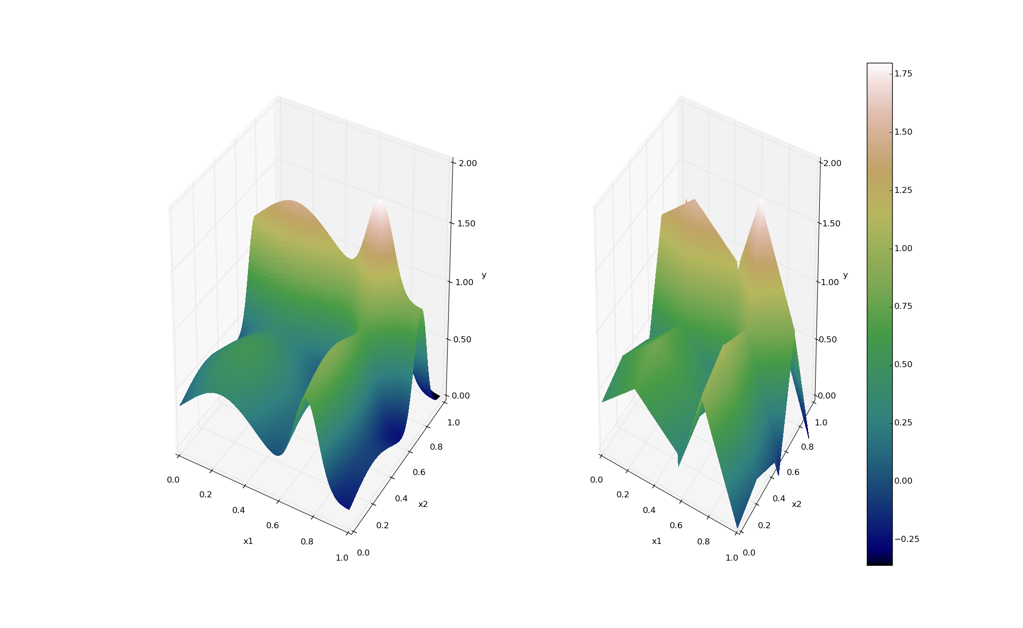
ROMs: a Quick Introduction
Output: Simulation outcome (success/failure, max clad temperature)
Consider a set of N data points
Build a surrogate model
Reduced Order Model
DataObjects
(TimePointSet)
Inputs: Initial and boundary conditions
≅

Slide 7
ROMs: a Quick Introduction
Basically we are trying to reduce the complexity of the original model
Pros:
Much faster computation of the output variable
Cons:
Presence of error in the ROM computed values
ROM (e.g., quadratic regressor)
≅
Original data (e.g., RELAP5)

Slide 8
Classes of ROMs
Model-Based
Prediction is performed using a blend of interpolation and regression algorithms
Examples:
Gaussian Process Models (GPMs)
Spline interpolator
Data-Based
Prediction is performed by solely considering the input data by using data searching algorithms
Examples:
Nearest neighbor

Slide 9
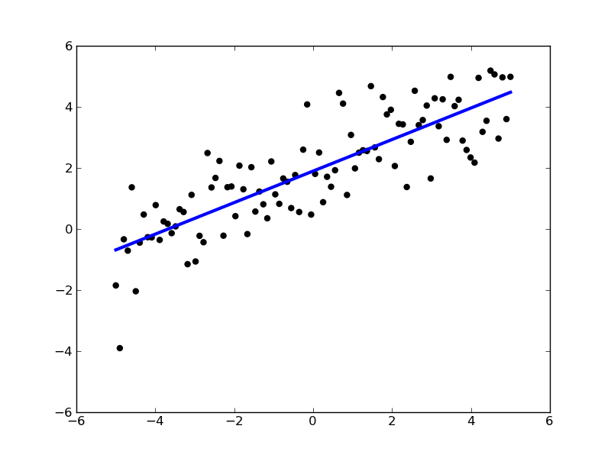
ROMs: Applications
Basic steps:
Sample original model
Train the ROM
Perform desired analysis with the ROM
instead of the original model
Range of applications:
Uncertainty quantification / Sensitivity analysis
Probabilistic Risk Analysis (PRA)
Accelerator for stochastic analysis (adaptive sampling)
Prediction models
Output y
Input x

Slide 10
ROMs Available in RAVEN
External libraries: Scikit-learn (http://scikit-learn.org)
Open source machine learning library for Python
Library for data mining and data analysis
Built on NumPy and SciPy
Internally C++ developed libraries: CROW
Generalized Polynomial Chaos (subject of a later presentation)
Multi-dimensional interpolators
ND Spline
ND Inverse-Weight

Slide 11
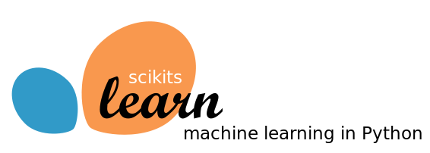
Scikit-Learn Library
Available:
Classification: identifying to which category an object belongs
Regression: predicting a continuous-valued attribute
Data clustering: grouping similar objects into sets
Dimensionality reduction: reducing the number of random variables
Data pre-processing: feature extraction and normalization
Examples:
Linear regression models
Support Vector Machines
Multi-Class classifiers
Naïve Bayes
Neighbors classifiers
Tree classifiers
Notes:
Add backup slides for some algorithms GPM and SVM

Slide 12
Scikit-Learn Library
Classification
Starting point: set of data points with labels
[features, class]_{i}
Objective: identify which class a new point [features] belong
Clustering
Starting point: set of data points
[features]_{I}
Objective: group data points based on a specific distance metrics
Y
(μ₁,σ₁²)
(μ₂,σ₂²)
X
Notes:
Add backup slides for some algorithms GPM and SVM

Slide 13
Scikit-Learn Library
Starting point: set of data points
[features]_{i}
Cardinality reduction
Objective: identify the most relevant features that keep data points unique
Outcome: Location of the points on the reduced space (e.g., line)
Regression
Objective: estimate the relationships among variables via a statistical process
Outcome: coefficients of the reduced space (e.g., m and c for linear interpolator )
Source: scikit-learn.org
Notes:
Add backup slides for some algorithms GPM and SVM

Slide 14
Multi-Dimensional Interpolators
CROW: Internally developed C++ library
Interpolation on any dimension
Response surface is created as an interpolation function given a set of data points defined on:
Sparse grid
Cartesian grid
Extension of the known 1-D interpolation schemes

Slide 15
Multi-Dimensional Interpolators
Two classes of algorithms
Inverse-Weight
No interpolation kernel is defined
Defined on sparse grid
Multi-Dimensional Spline
Defined on cartesian grid
Based on multi-dimensional spline kernel
Continuity of the derivative is preserved
where:

Slide 16
RAVEN ensemble modeling

Slide 17
Ensemble Model
A new model entity (e.g., class), named EnsembleModel, has been developed:
Assemble multiple models of other categories, identifying the input/output connections and the order of execution
Notes:
Sometimes, multiple models need to interface with each other since the initial conditions of some are dependent on the outcomes of others

Slide 18
Ensemble Model: Chain of Models
Model 1
Model N-1
Model N
Model 2
Model 1
Model 3
Notes:
Sometimes, multiple models need to interface with each other since the initial conditions of some are dependent on the outcomes of others

Slide 19
Ensemble Model: Non Linear
Notes:
Sometimes, multiple models need to interface with each other since the initial conditions of some are dependent on the outcomes of others

Slide 20
RAVEN ensemble modeling: 3 simple examples

Slide 21

Ensemble Model: Example 1
1-Dimensional heat conduction transient (in a slab of thickness L=1 m):
EM1, heat conduction partial differential equation:
EM2, thermal conductivity (input of EM1) as function of the average temperature in the slab boundary conditions:
EM2
EM1

Slide 22
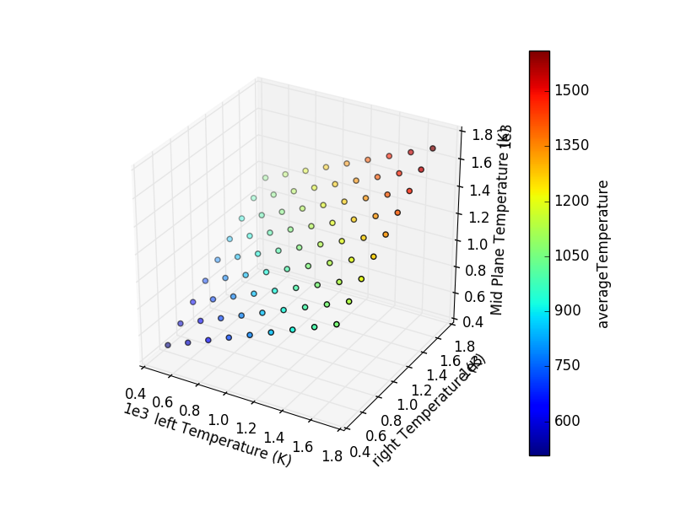
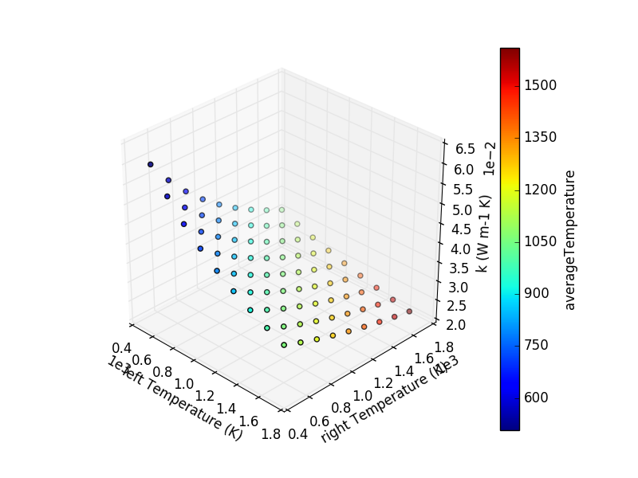
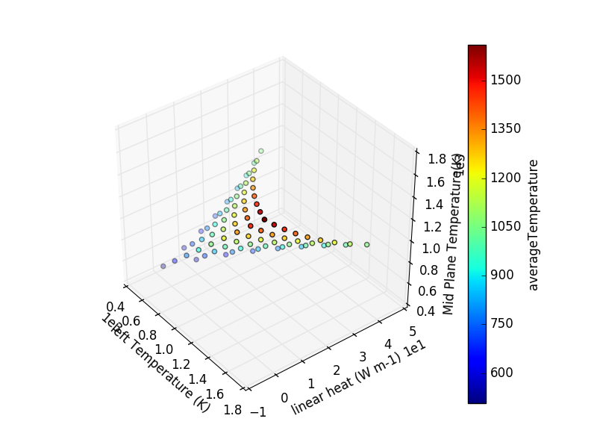
Ensemble Model: Example 2
1-Dimensional heat conduction transient (in a slab of thickness L=1 m):
EM1, heat conduction partial differential equation:
EM2, thermal conductivity (input of EM1) as function of the average temperature in the slab (solution):
EM1
EM2

Slide 23
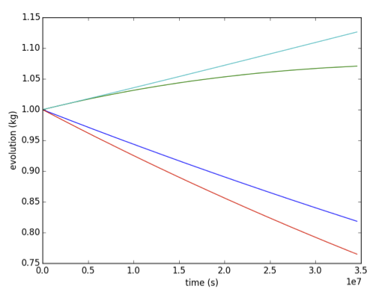
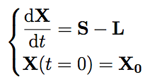
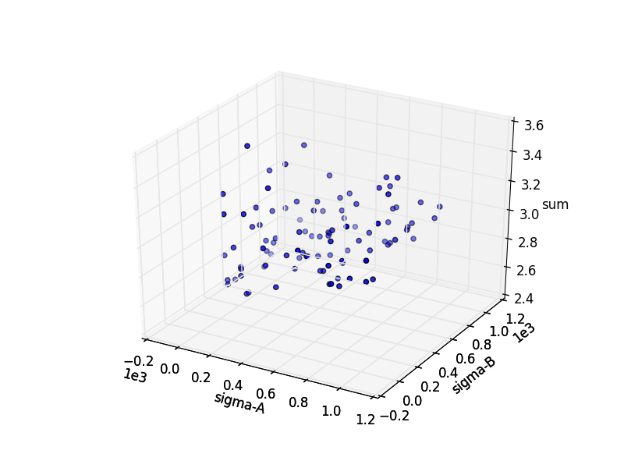
Ensemble Model: Example 3
Also codes can be used in the Ensemble modeling.
EM1: Code, Analytical Bateman
Transmutation
EM2: External Model, compute the sum of the final outcomes of EM1
EM1
EM2

Slide 24
RAVEN Examples

Slide 25
RAVEN examples: ROMs

Slide 26
ROM Modeling Within RAVEN
All modeling steps that involve ROMs are available in RAVEN
Create ROMs from a database
Perform statistical analysis using ROMs

Slide 27
Exercise 1: Create a ROM from a database

Slide 28
Workflow
Sample model
Create database
Train a ROM
Sample a ROM
Stat Analysis
ROM_example.xml

Slide 29
Sample a Model and Create a Database
Distributions
Models
Samplers
Databases
DataObjects
Steps
<Distributions>
<Normal name='normal_trunc'>
<mean>0.5</mean>
<sigma>0.1</sigma>
<lowerBound>0.0</lowerBound>
<upperBound>1.0</upperBound>
</Normal>
<Normal name='normal'>
<mean>2.0</mean>
<sigma>0.2</sigma>
</Normal>
<Uniform name='uniform'>
<upperBound>4.0</upperBound>
<lowerBound>1.0</lowerBound>
</Uniform>
</Distributions>
Truncation parameters
Input file name: sample_model.xml

Slide 30
Sample a Model and Create a Database
Distributions
Models
Samplers
Databases
DataObjects
Steps
<Models>
<ExternalModel name='PythonModule' subType=’’ ModuleToLoad='workshop_model’>
<variables>
x1,
x2,
x3,
y1,
y2,
y3,
y4,
y5
</variables>
</ExternalModel>
</Models>
Input variables
File name: workshop_model.py
Output variables
Input file name: sample_Function.xml

Slide 31
Sample a Model and Create a Database
Distributions
Models
Samplers
Databases
DataObjects
Steps
<variable name>
<distribution>
<grid points>
<Samplers>
<Grid name='Grid_function'>
<variable name='x1' >
<distribution>normal_trunc</distribution>
<grid type='value’ construction='equal' steps='5'>0.0 1.0</grid>
</variable>
<variable name='x2' >
<distribution>normal</distribution>
<grid type='value’ construction='equal' steps='5'>1.5 2.5</grid>
</variable>
<variable name='x3' >
<distribution>uniform</distribution>
<grid type='value’ construction='equal' steps='5’>1.0 4.0</grid>
</variable>
</Grid>
</Samplers>
Input file name: sample_Function.xml

Slide 32
Sample a Model and Create a Database
Distributions
Models
Samplers
Databases
DataObjects
Steps
<Databases>
<HDF5 name='out_db'/>
</Databases>
<DataObjects>
<TimePointSet name='Data1'>
<Input>x1,x2,x3</Input>
<Output>OutputPlaceHolder</Output>
</TimePointSet>
<TimePointSet name='inputPlaceHolder'>
<Input>x1,x2,x3</Input>
<Output>y1,y2,y3,y4,y5</Output>
</TimePointSet>
</DataObjects>
<DataObjects>
<Inputs>
<Output>
Input file name: sample_Function.xml

Slide 33
Sample a Model and Create a Database
Distributions
Models
Samplers
Databases
DataObjects
Steps
<Steps>
<MultiRun name='FirstMRun'>
<Input class='DataObjects' type='TimePoint' >inputPlaceHolder</Input>
<Model class='Models' type='ExternalModel’>PythonModule</Model>
<Sampler class='Samplers' type='Grid' >Grid_function</Sampler>
<Output class='DataObjects’ type='TimePointSet’ >outGRID</Output>
<Output class='Databases' type='HDF5' >out_db</Output>
<Output class='OutStreamManager' type='Print' >out_dump</Output>
<Output class='OutStreamManager' type='Plot' >plotResponseFunction</Output>
</MultiRun>
</Steps>
Model file
Step
Database
Model info
Sampler
DataObjects
Input file name: sample_Function.xml

Slide 34
Workflow
Sample model Create database
sample_Function.xml
Train a ROM
Sample ROM
sample_ROM.xml

Slide 35
Train and Sample a ROM
Distributions
Models
Samplers
Databases
DataObjects
Steps
<Distributions>
<Normal name='normal_trunc'>
<mean>0.5</mean>
<sigma>0.1</sigma>
<lowerBound>0.0</lowerBound>
<upperBound>1.0</upperBound>
</Normal>
<Normal name='normal'>
<mean>2.0</mean>
<sigma>0.2</sigma>
</Normal>
<Uniform name='uniform'>
<upperBound>4.0</upperBound>
<lowerBound>1.0</lowerBound>
</Uniform>
</Distributions>
Truncation parameters
Input file name: sample_ROM.xml

Slide 36
Train and Sample a ROM
Distributions
Models
Samplers
Databases
DataObjects
Steps
<Models>
<ROM name='ROM4' subType='NDinvDistWeight'>
<Features>x1,x2,x3</Features>
<Target>y4</Target>
<p>3</p>
</ROM>
</Models>
Multi-dimensional interpolator (CROW)
Input file name: sample_ROM.xml

Slide 37
Train and Sample a ROM
Distributions
Models
Samplers
Databases
DataObjects
Steps
<Samplers>
<Grid name=’Grid_ROM'>
<variable name='x1'>
<distribution>normal_trunc</distribution>
<grid type='value' construction='equal' steps='10’>0.0 1.0</grid>
</variable>
<variable name='x2’>
<distribution>normal</distribution>
<grid type='value' construction='equal' steps='10’>1.5 2.5</grid>
</variable>
<variable name='x3’>
<distribution>uniform</distribution>
<grid type='value' construction='equal' steps='10'>1.0 4.0</grid>
</variable>
</Grid>
</Samplers>
Finer grid
Input file name: sample_ROM.xml

Slide 38
Train and Sample a ROM
Distributions
Models
Samplers
Databases
DataObjects
Steps
<Databases>
<HDF5 name='out_db' filename='out_db.h5' directory='path2DB/DBStorage/'/>
</Databases>
<DataObjects>
<TimePointSet name='outGRID_y4'>
<Input>x1,x2,x3</Input>
<Output>y4</Output>
</TimePointSet>
<TimePointSet name='outROM_y4'>
<Input>x1,x2,x3</Input>
<Output>y4</Output>
</TimePointSet>
<TimePointSet name='Data1'>
<Input>x1,x2,x3</Input>
<Output>OutputPlaceHolder</Output>
</TimePointSet>
</DataObjects>
Database containing training dataset
Training DataObject
ROM generated DataObject
Input file name: sample_ROM.xml

Slide 39
Train and Sample a ROM
Distributions
Models
Samplers
Databases
DataObjects
Steps
<Steps>
<IOStep name='extract_data4'>
<Input class='Databases' type='HDF5' >out_db</Input>
<Output class='DataObjects' type='TimePointSet' >outGRID_y4</Output>
</IOStep>
<RomTrainer name='rom_trainer4'>
<Input class='DataObjects' type='TimePointSet' >outGRID_y4</Input>
<Output class='Models' type='ROM' >ROM4</Output>
</RomTrainer>
<MultiRun name=’RunRom4'>
<Input class='DataObjects’ type='TimePointSet’ >Data1</Input>
<Model class='Models' type=’ROM’ >ROM4</Model>
<Sampler class='Samplers' type='Grid' >Grid_ROM</Sampler>
<Output class='DataObjects’ type='TimePointSet' >outROM_y4</Output>
</MultiRun>
</Steps>
Input file name: sample_ROM.xml

Slide 40
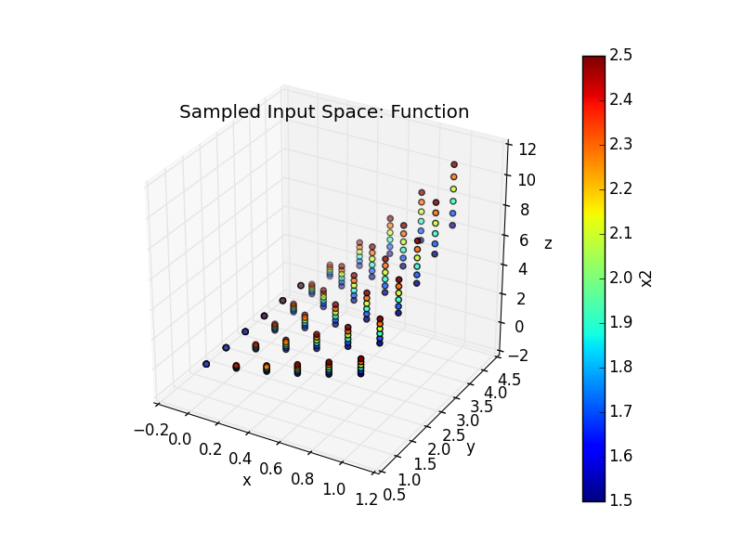
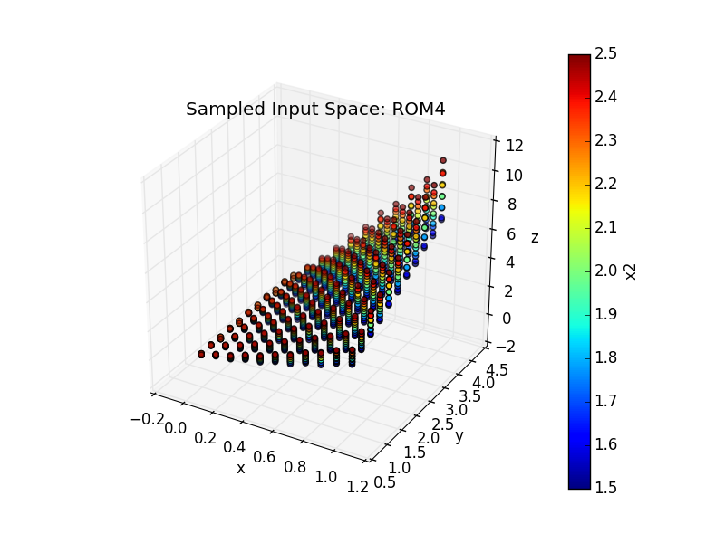
Train and Sample a ROM
Output: y₃
Inputs: x₁, x₂, x₃

Slide 41
Thank you Questions?

